Slide 1

Trehal
Capstone Graduation Project 22

Slide 3
Project Description and Background
University students face great difficulties during their study period in various aspects, such as transportation, because each person has different circumstances that cause difficulty in access and movement, such as the long distance , lack of driver's licenses, inability to own a car, etc. the majority tends to choose transportation companies for daily transportation, and the need for them is increasing with the increase in the number of students now and in the future.Trehal application is a mobile application that provides female students wishing to register for a transport company, with higher and better features to achieve the convenience of the student.

Slide 4
Problem Statement
University students have many problems with transportation, such as searching for delivery companies to the university, and difficulty of comparing delivery companies to the university in terms of prices and quality of the car, Also students must call every delivery company to the university to obtain information about these companies.

Slide 5
Aim of project
This project aims to study the benefits that applications will provide to ease students and staff communication with delivery companies easily, by providing a unique and easy-to-use Android application. as well as enabling the student to obtain all the information he needs about the driver and the car

Slide 6
Goals and Objectives
The main objective of this project is to develop a mobile application called Trehal that.
Simplify the search process for the Students.
Helps students compare prices and choose one that suits them best.
Provide information to students regarding the service providers.
Enables students to add feedback to the transportation companies.

Slide 7
Software and Hardware requirement
Software:
Language: Java
Tools: Android studio
Server: WAMP
Hardware Requirements:
RAM:8GB
Space on disk: minimum 512GB

Slide 8
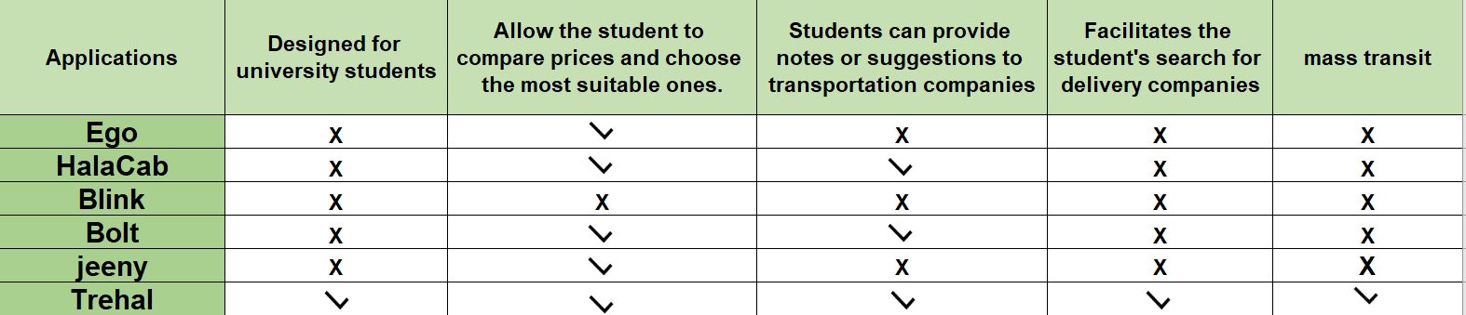
Table 1: 2.1 Comparison

Slide 9
Data Collection
Most of the methods used to collect information and understand the problem were through:
1-surveys
•It is clear that the majority (42.9%) used WhatsApp and Instagram as a way to search for transport companies
•57% of female students face problems in comparing prices

Slide 10
Data Collection
2- The interview
Where the interviews included number of students ranging between 10 to 18 students
-The question in each of them was. What is the most dilemma faced by university students with transportation companies?

Slide 11
Functional requirements
1-It simplifies students' search for transport companies.
2-contributes greatly to providing correct and complete information about each company and its services.
3-It helps in comparing prices between companies.
4-allows writing comments to other students and making suggestions to transport companies.

Slide 12
Non-Functional requirements
1- It is easy and clear to use Which makes it high-performance.
2- It has a bright and cheery design and icons

Slide 13
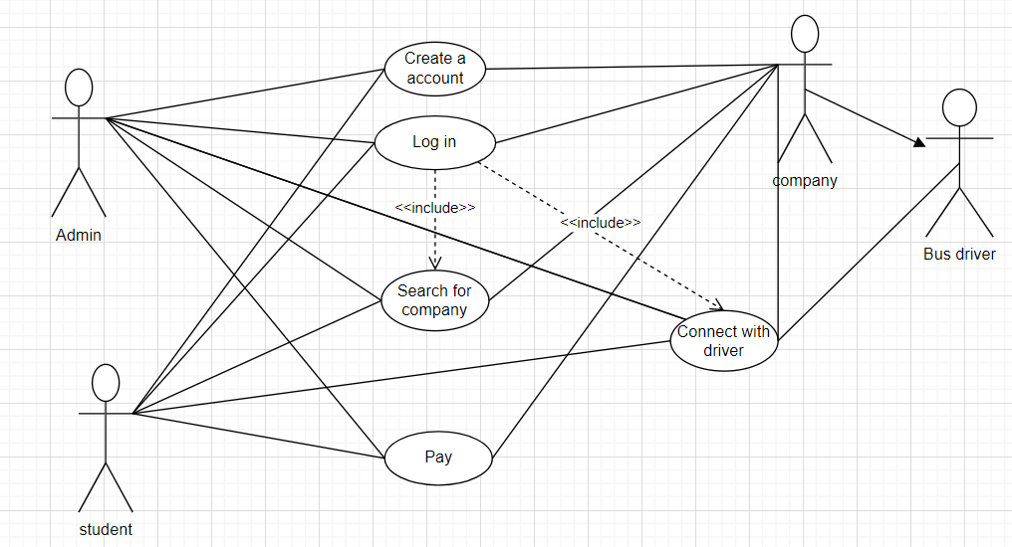
USE CASE DIAGRAM

Slide 14
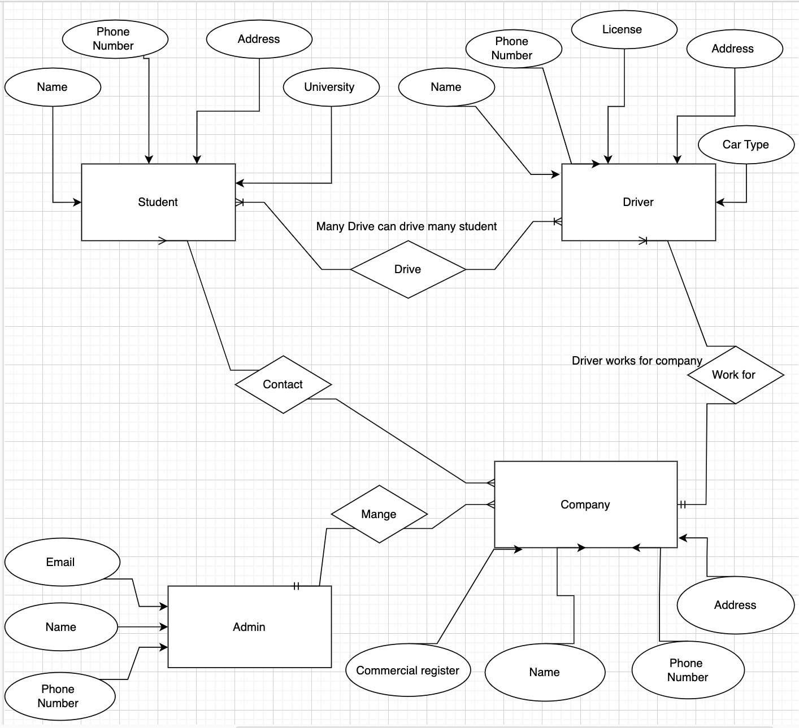
ER DIAGRAM
Weißt du, was dir hilft, deinen Standpunkt klar zu machen? Listen wie diese hier:
Sie sind einfach
Du kannst deine Ideen klar organisieren
Du wirst nie vergessen, Milch zu kaufen!
Und das Wichtigste: Das Publikum wird den Sinn deiner Präsentation nicht verfehlen

Slide 15
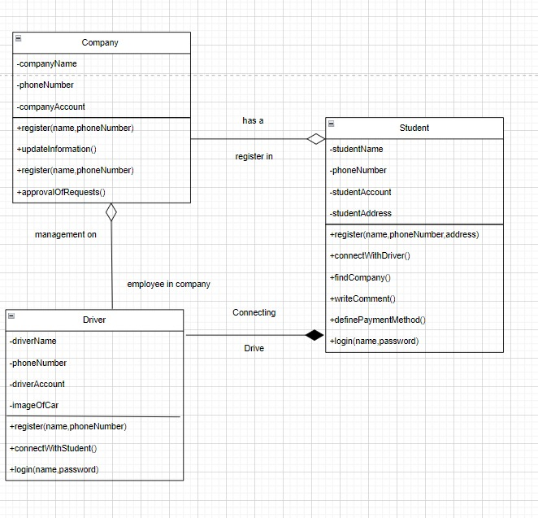
CLASS DIAGRAM

Slide 16
References
[1]https://www.alriyadh.com/731175
[2]https://www.androiderr.com/2021/08/ego-saudi.html
[3]https://www.halacab.com/about
[4] https://apps.apple.com/sa/app/blink-ksa-%D8%A8%D9%84%D9%8A%D9%86%D9%83/id1550103864
[5]https://bolt.eu/en/careers/about-bolt/
[6]https://www.eqrae.com/%D8%AA%D8%AC%D8%B1%D8%A8%D8%AA%D9%8A-%D9%85%D8%B9-%D8%AA%D8%B7%D8%A8%D9%8A%D9%82-%D8%AC%D9%8A%D9%86%D9%8A/

